Slide 1

SPONSORS

Slide 2



Getting Started with ASP.NET Core in VS Code
@Scott_Addie

Slide 3
Getting Started with ASP.NET Core in VS Code
@Scott_Addie

Slide 4
New Terminology (<= RC1)
DNVM (.NET Version Manager)
DNX (.NET Execution Environment)
DNU (.NET Development Utility)
Installation of DN* Tooling:
https://get.asp.net/

Slide 5



New Choices
ASP.NET 5 App
DNX
.NET Framework
dnx451, dnx452, dnx46
.NET Core
dnxcore50
Both
dnx46 & dnxcore50
IIS
Kestrel

Slide 6
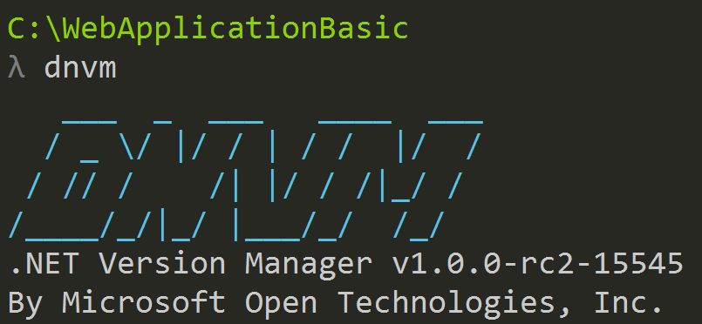
DNVM
Framework versioning manager
Registers frameworks in user profile
%USERPROFILE%\.dnx\runtimes
Runtime types:
Clr
rely on .NET being installed on machine
CoreClr
can be deployed w/ app

Slide 7
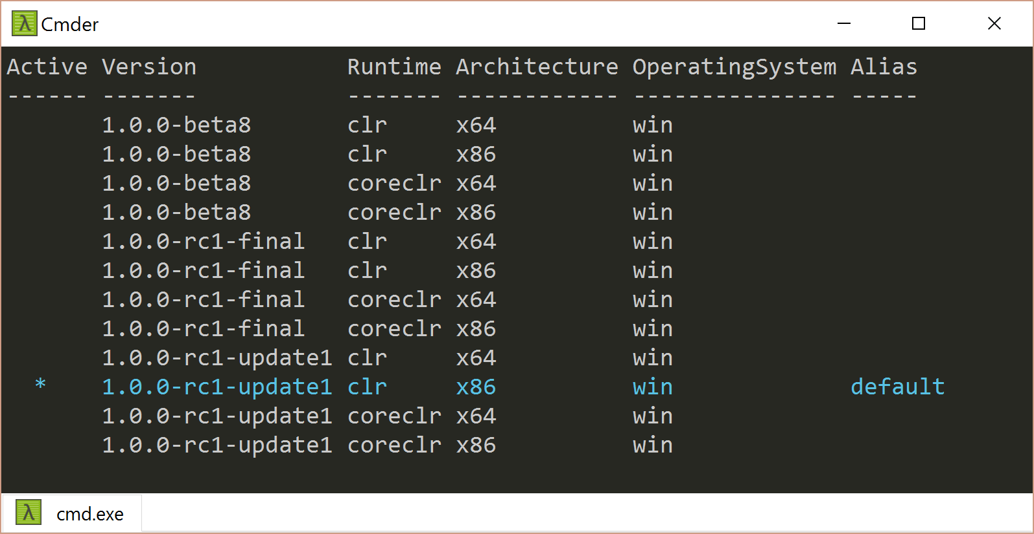
DNVM – View Framework Inventory
> dnvm list

Slide 8
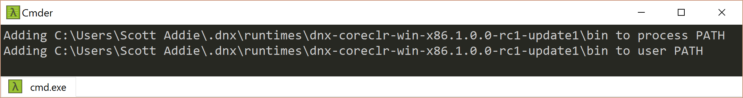
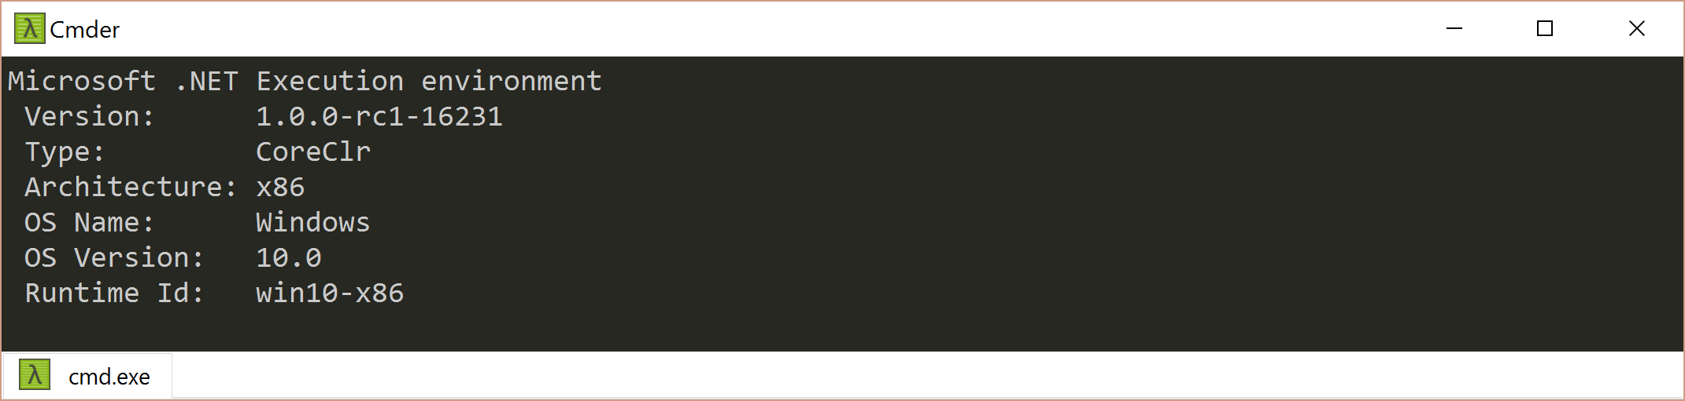
DNVM – Set Default Runtime
> dnvm use 1.0.0-rc1-update1 –r coreclr –a x86 –p
> dnx --version

Slide 9
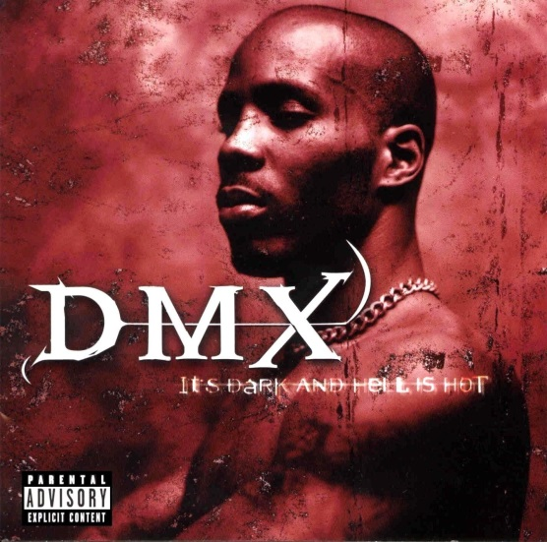
DNX
SDK & runtime environment
Built by ASP.NET team to make framework…
X-plat
Windows, Mac OS X, Linux
Runtime agnostic
.NET Core, .NET Fx, Mono, etc.
Introduced a confusing new .NET application model
ASP.NET Console App
Not a rapper from the late ‘90s

Slide 10
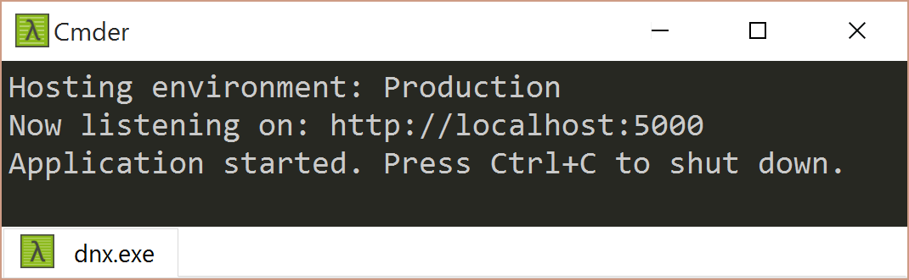
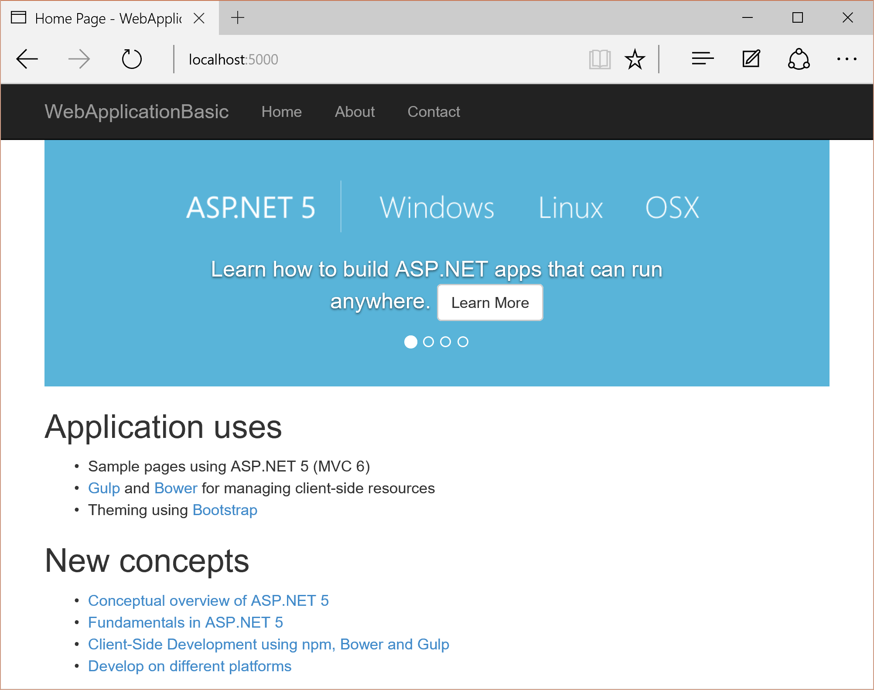

DNX – Start Web Server
project.json
> dnx web
Execute
Start
Browse

Slide 11
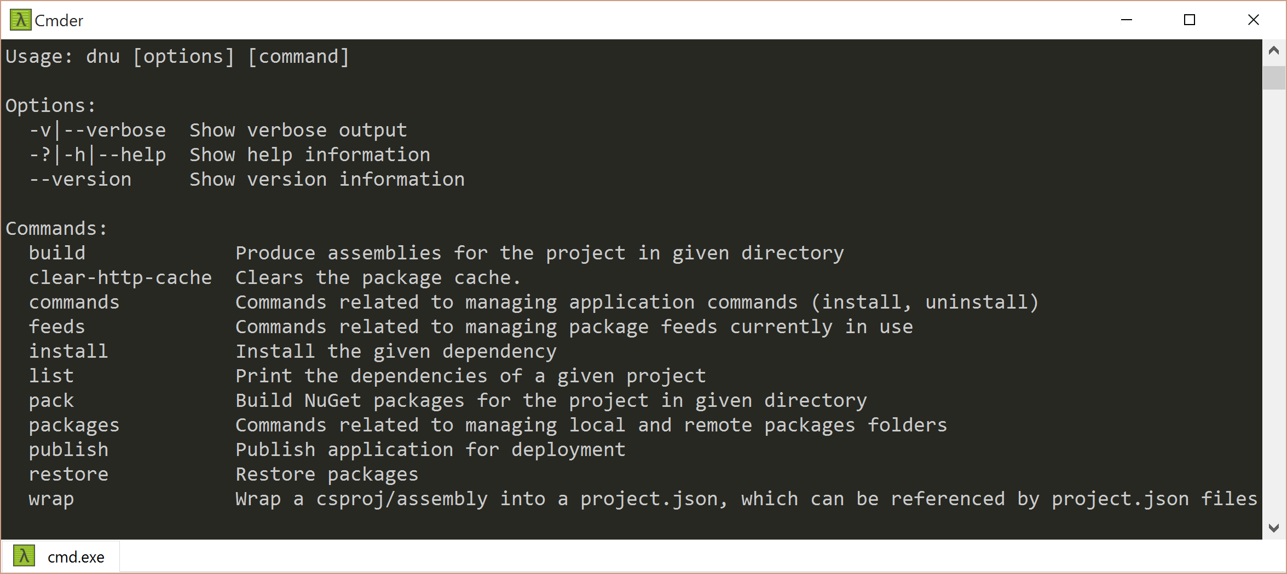
DNU
NuGet Package Restore
> dnu restore
Build App
> dnu build
Commands Management
> dnu install
Publish App
> dnu publish

Slide 12
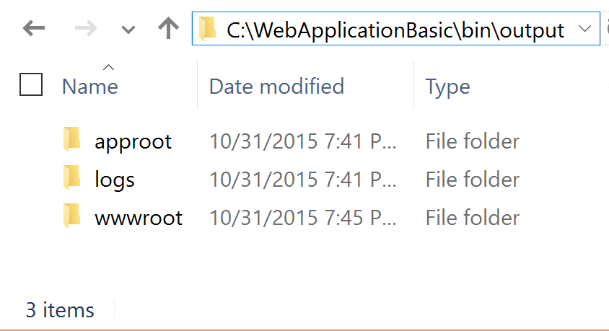
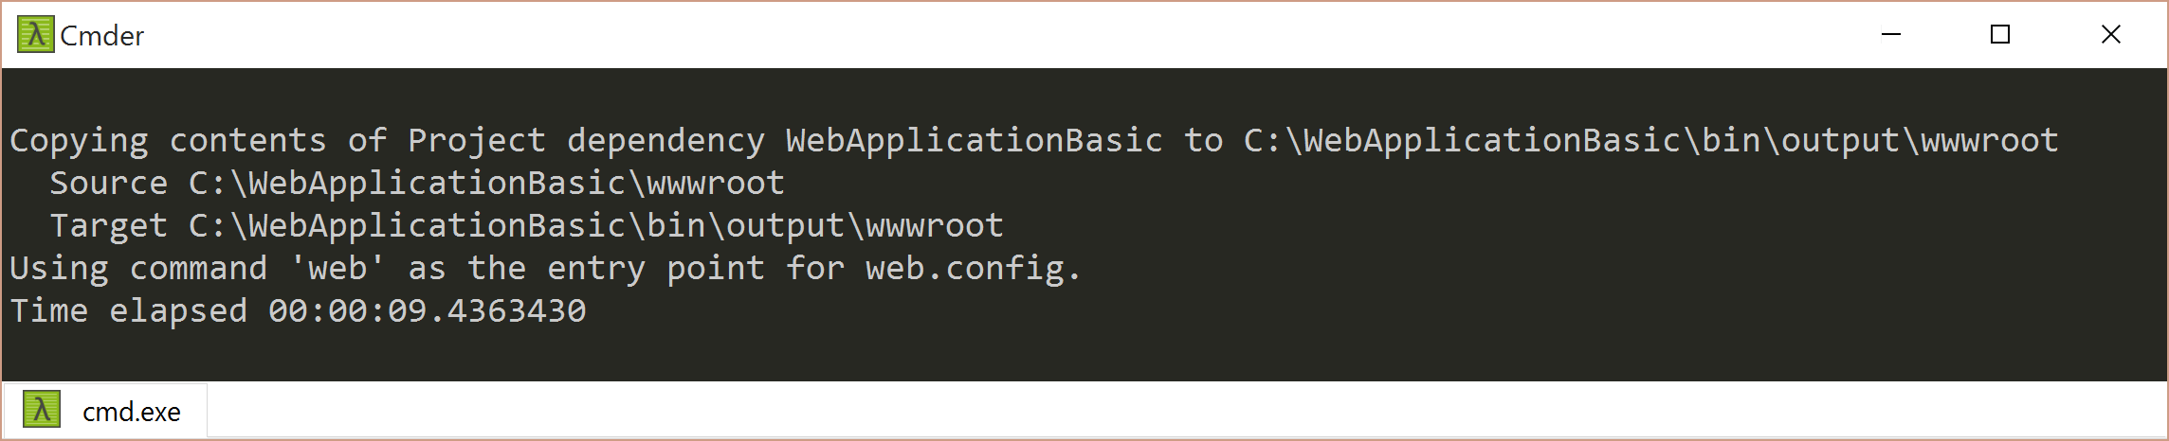
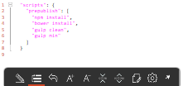
DNU – Publish App
project.json
Execute
> dnu publish
Publish
Write

Slide 13
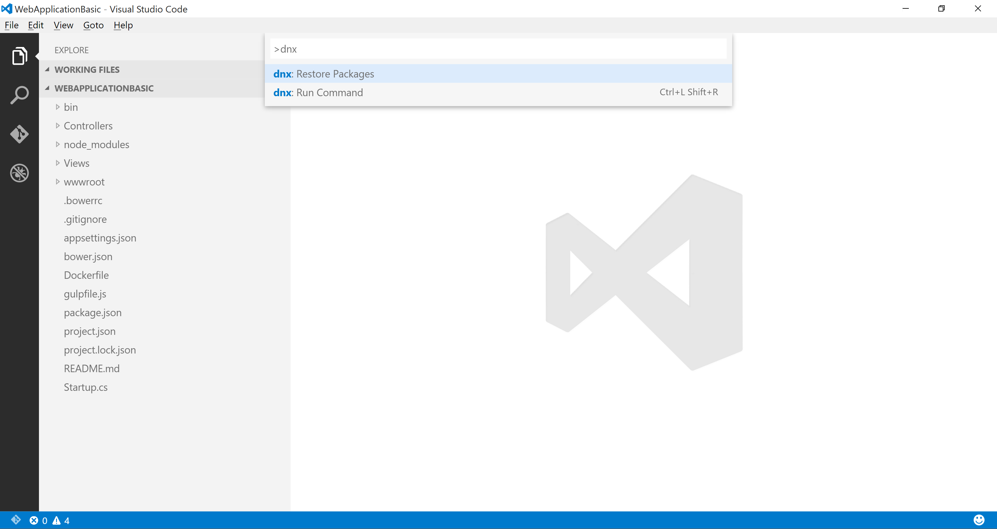
DN* Support in VS Code
Command Palette (F1)
> dnu restore
> dnx web

Slide 14
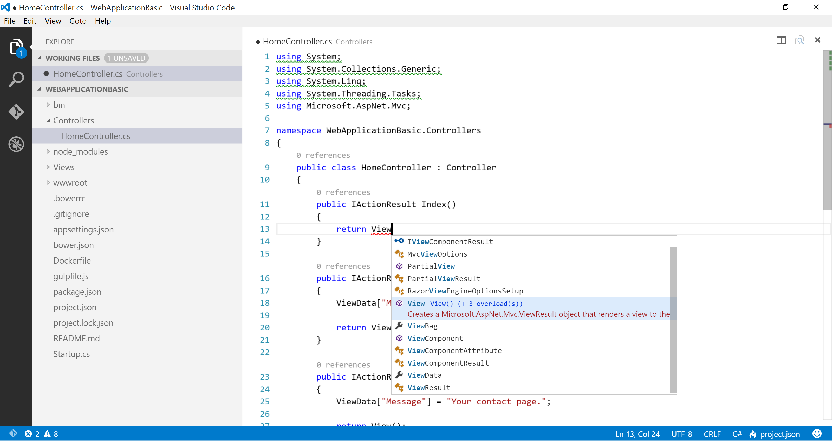
C# Support in VS Code
Unused References
Code Lens
IntelliSense
OmniSharp Integration

Slide 15



Scaffolding Support
OmniSharp
Yeoman
generator-aspnet

Slide 16
Scaffolding via Command Shell
generator-aspnet

Slide 17
Scaffolding in Command Shell

Slide 18
Scaffolding in Editor
vscode-yo

Slide 20
> DN* Demo
ASP.NET 5 Web Application in VS Code

Slide 21

Platform Evolution up to RC2
KRuntime
XRE
DNX
.NET Core CLI

Slide 22
CLI Evolution for RC2
DNU
DNX
DNVM
> dotnet

Slide 23
DNX-to-dotnet Command Mappings
Old | New
dnu restore | dotnet restore
dnu pack | dotnet pack
dnu build | dotnet build
dnu publish | dotnet publish
dnu run | dotnet run
dnx-watch | dotnet watch
dnx ef | dotnet ef
dnx test | dotnet test
user-secrets | dotnet user-secrets

Slide 24
> dotnet Demo
ASP.NET Core Web Application in VS Code

Slide 25
Resources
Introducing ASP.NET Core 1.0 (//build/ 2016 session)
ASP.NET Community Standups
Getting Started with .NET Core
Official ASP.NET vNext Docs

Slide 26




Thank you!
Scan QR for slides & code:
GitHub.com/scottaddie/vscode-aspnet5
ScottAddie.com
@Scott_Addie
LinkedIn.com/in/scottaddie

